Slide 1
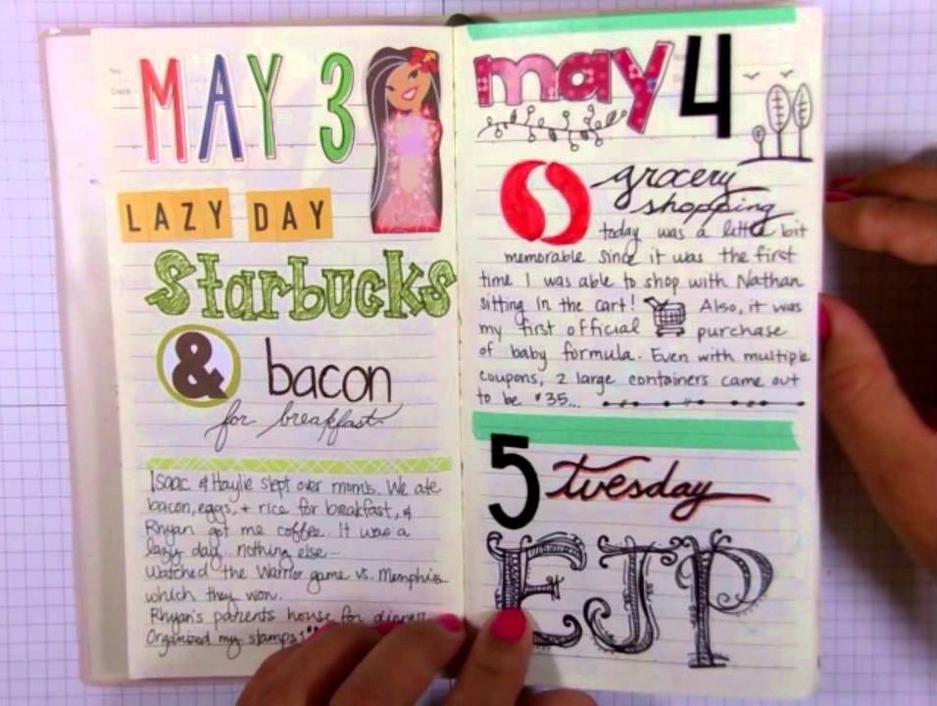
Creative Journaling

Slide 2
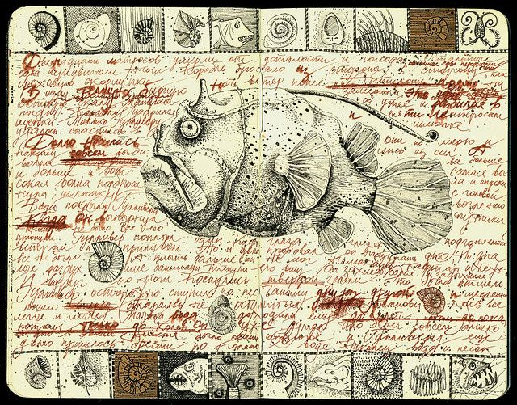

Slide 3
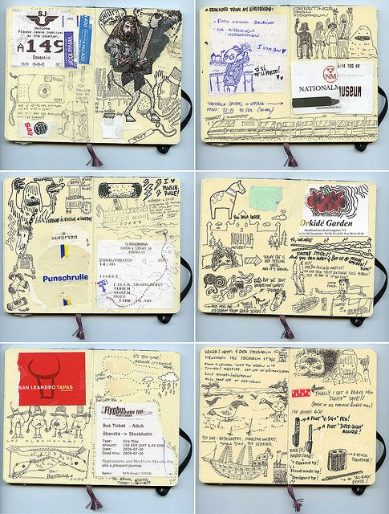

Slide 4
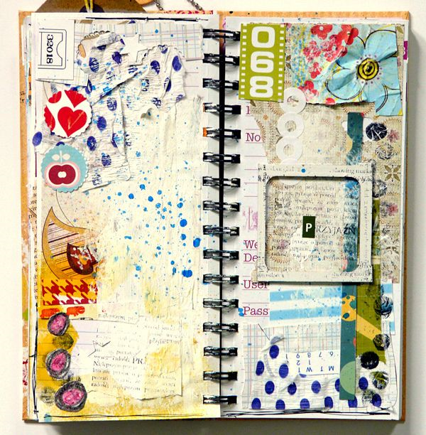

Slide 5
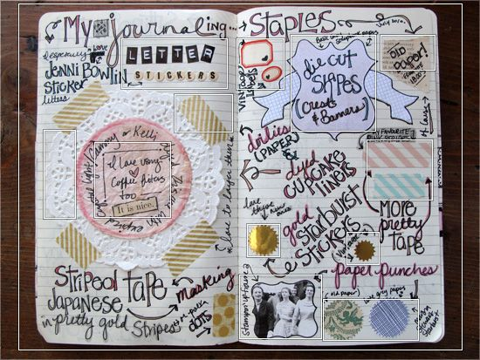

Slide 6
Creative journals can be:
Recycled old books as a base for your work
Or
A blank book
They can contain:
Drawings
Writing
Tickets
Napkins
Stuff collected from your 5 week break
Paper folding
…anything…!!!

